Slide 1

Introduction to Git
By Bhujan Sharma

Slide 2
What is Git?
It is a distributed revision control and source code management system.
It stores data as a snapshot of a project over time and stores a reference to that snapshot.
Each commit is a snapshot of the repository.
Each client has a fully mirrored repository, therefore if a server crashes, the repository is still accessible.
It does not rely on a central server and most of the operations can be done offline.
Git is released under GPL’s open source license. It is available freely over the internet.
It gives a huge benefit in terms of speed, compression, security and storage.

Slide 3
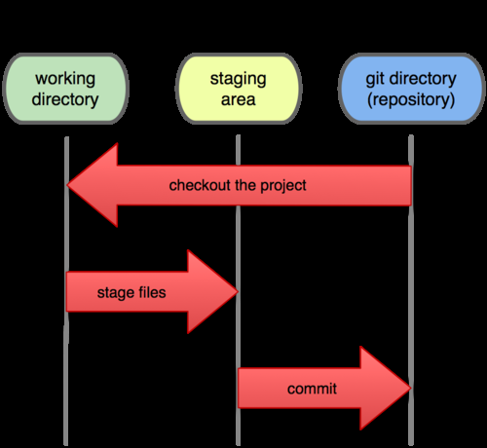
Working locally on Git
Git stores almost all data on its local database, so there are no network latency overhead as compared to CVCS.
Instead of having to pull query results remotely, Git simply queries its local database, displaying results instantly.
If you have no network connection, you can still work on a project, stage it and commit it to the local repository. When a connection is available, you can push the changes to a remote repository.

Slide 4

Working remotely on Git
Working remotely is straightforward in Git. All you have to do is clone a remote repository that you want to collaborate on by specifying its url.
The project data will then be downloaded to your local Git directory.
Managing remote repositories includes knowing how to add remote repositories, remove those that are no longer valid and manage various remote branches.

Slide 5
Basic Git Commands
To initialize a local Git repository: git init
To view current state of a project: git status
To add a file to the stage: git add <filename>
To commit the changes: git commit –m “Commit Message”
To view the history: git log
To add a remote repository: git remote add <repository name> <repository url>
To pull remote repository: git pull <repository name> master
To push local changes to remote repository: git push -u <repository name> master
To create a branch: git branch <branch name>
To switch to a branch: git checkout <branch name>

Slide 6


Slide 7
Questions?

